Slide 1
Hybrid TimeMixer-XGBoost PM2.5 Forecasting App
DAP391m Final Slide Report
Artificial Intelligence & Data Science Project
FPT University | Ho Chi Minh City
Students: Dong Bao Han | Tran Loi Kieu Nhi | Pham Hoang Tu Ngan
Supervisor / Mentor: Le Vo Minh Thu
Five UK monitoring stations - five seeds - 30 epochs
Target: hourly PM2.5 | Horizons: 1, 6, 12, 24, 48 hours

Slide 2
Presentation Outline
PART 1: Problem and Data Understanding
Slides 3-8: problem, research questions, dataset, EDA, and SQL-style analysis
Slides 12-16: partitioning, model training, evaluation, tuning, and final pipeline
PART 3: Modelling and Evaluation
PART 2: Feature and Visualization Design
Slides 9-11: feature engineering, advanced visualization, and interactive dashboard
Slides 17-20: prototype, deployment ideas, conclusion, and Q&A
PART 4: Application and Reflection

Slide 3
Step 1 - Problem Understanding
Goal: forecast hourly PM2.5 concentration for multiple future horizons.
Why it matters
? PM2.5 changes quickly and affects public-health interpretation.
? A single-station result is weak, so the project evaluates five monitoring stations.
? The study checks whether residual correction can safely improve TimeMixer forecasts.
Forecasting task: predict 1, 6, 12, 24, and 48 hours ahead using historical PM2.5 only.

Slide 4
Research Questions
RQ1: Which model forecasts hourly PM2.5 most accurately across horizons?
Key question | Description
Task | Forecast hourly PM2.5 at 1, 6, 12, 24 and 48 hours.
Scope | Five UK traffic, urban-background and rural stations.
Inputs | Historical PM2.5, calendar, missingness and instrument regime.
Challenge | Unequal histories, long gaps, negative readings and sensor changes.
Success | Lower locked-test MAE than strong matched baselines.
RQ2: Does the gated TimeMixer-XGBoost residual layer improve the TimeMixer base model?

Slide 5
Step 2 - Data Understanding
Dataset scope
# | Research question
RQ1 | Does the gated hybrid improve TimeMixer and the strongest matched comparator?
RQ2 | How does effectiveness vary across stations and forecast horizons?
RQ3 | Do de-biasing, robust loss and rolling calibration prevent over-correction?
RQ4 | Are conclusions stable across five seeds and station data-quality regimes?
? Five UK stations: MY1, BIR_A4540, HP1, CHB, and KC1.
? Hourly PM2.5 time series.
? Site types include urban traffic, urban background, and rural background.

Slide 6
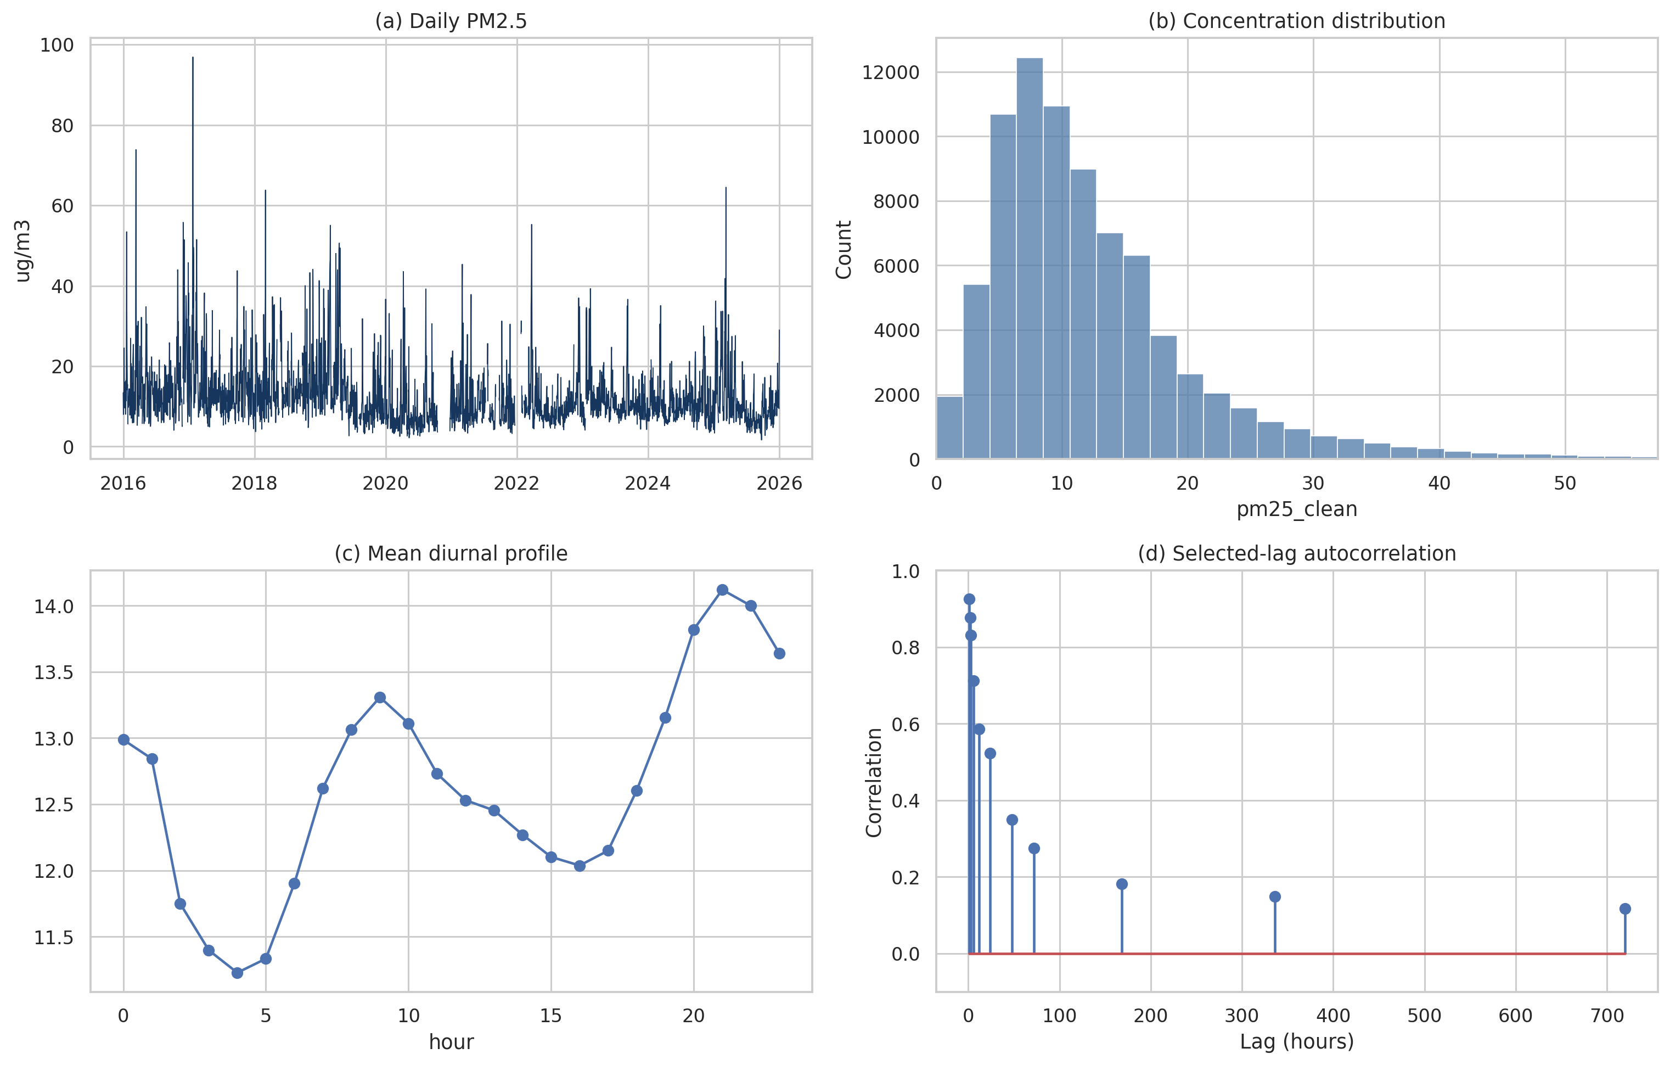
Step 3 - EDA: Univariate Analysis
What was inspected?
Property | Value
Source | UK-Air hourly PM2.5 exports
Stations | MY1, BIR_A4540, HP1, CHB, KC1
Site types | 2 traffic, 2 urban background, 1 rural
History | Station-specific records through 2025
Target | Hourly PM2.5 concentration (µg/m³)
Design | Independent model fitting per station
? PM2.5 distribution and extreme values.
? Missing-value rate and annual coverage.
? Negative measurements and long gaps.
? Hourly and seasonal patterns.
Finding
The PM2.5 series is noisy, skewed, and gap-prone, so cleaning decisions must be auditable before modelling.

Slide 7
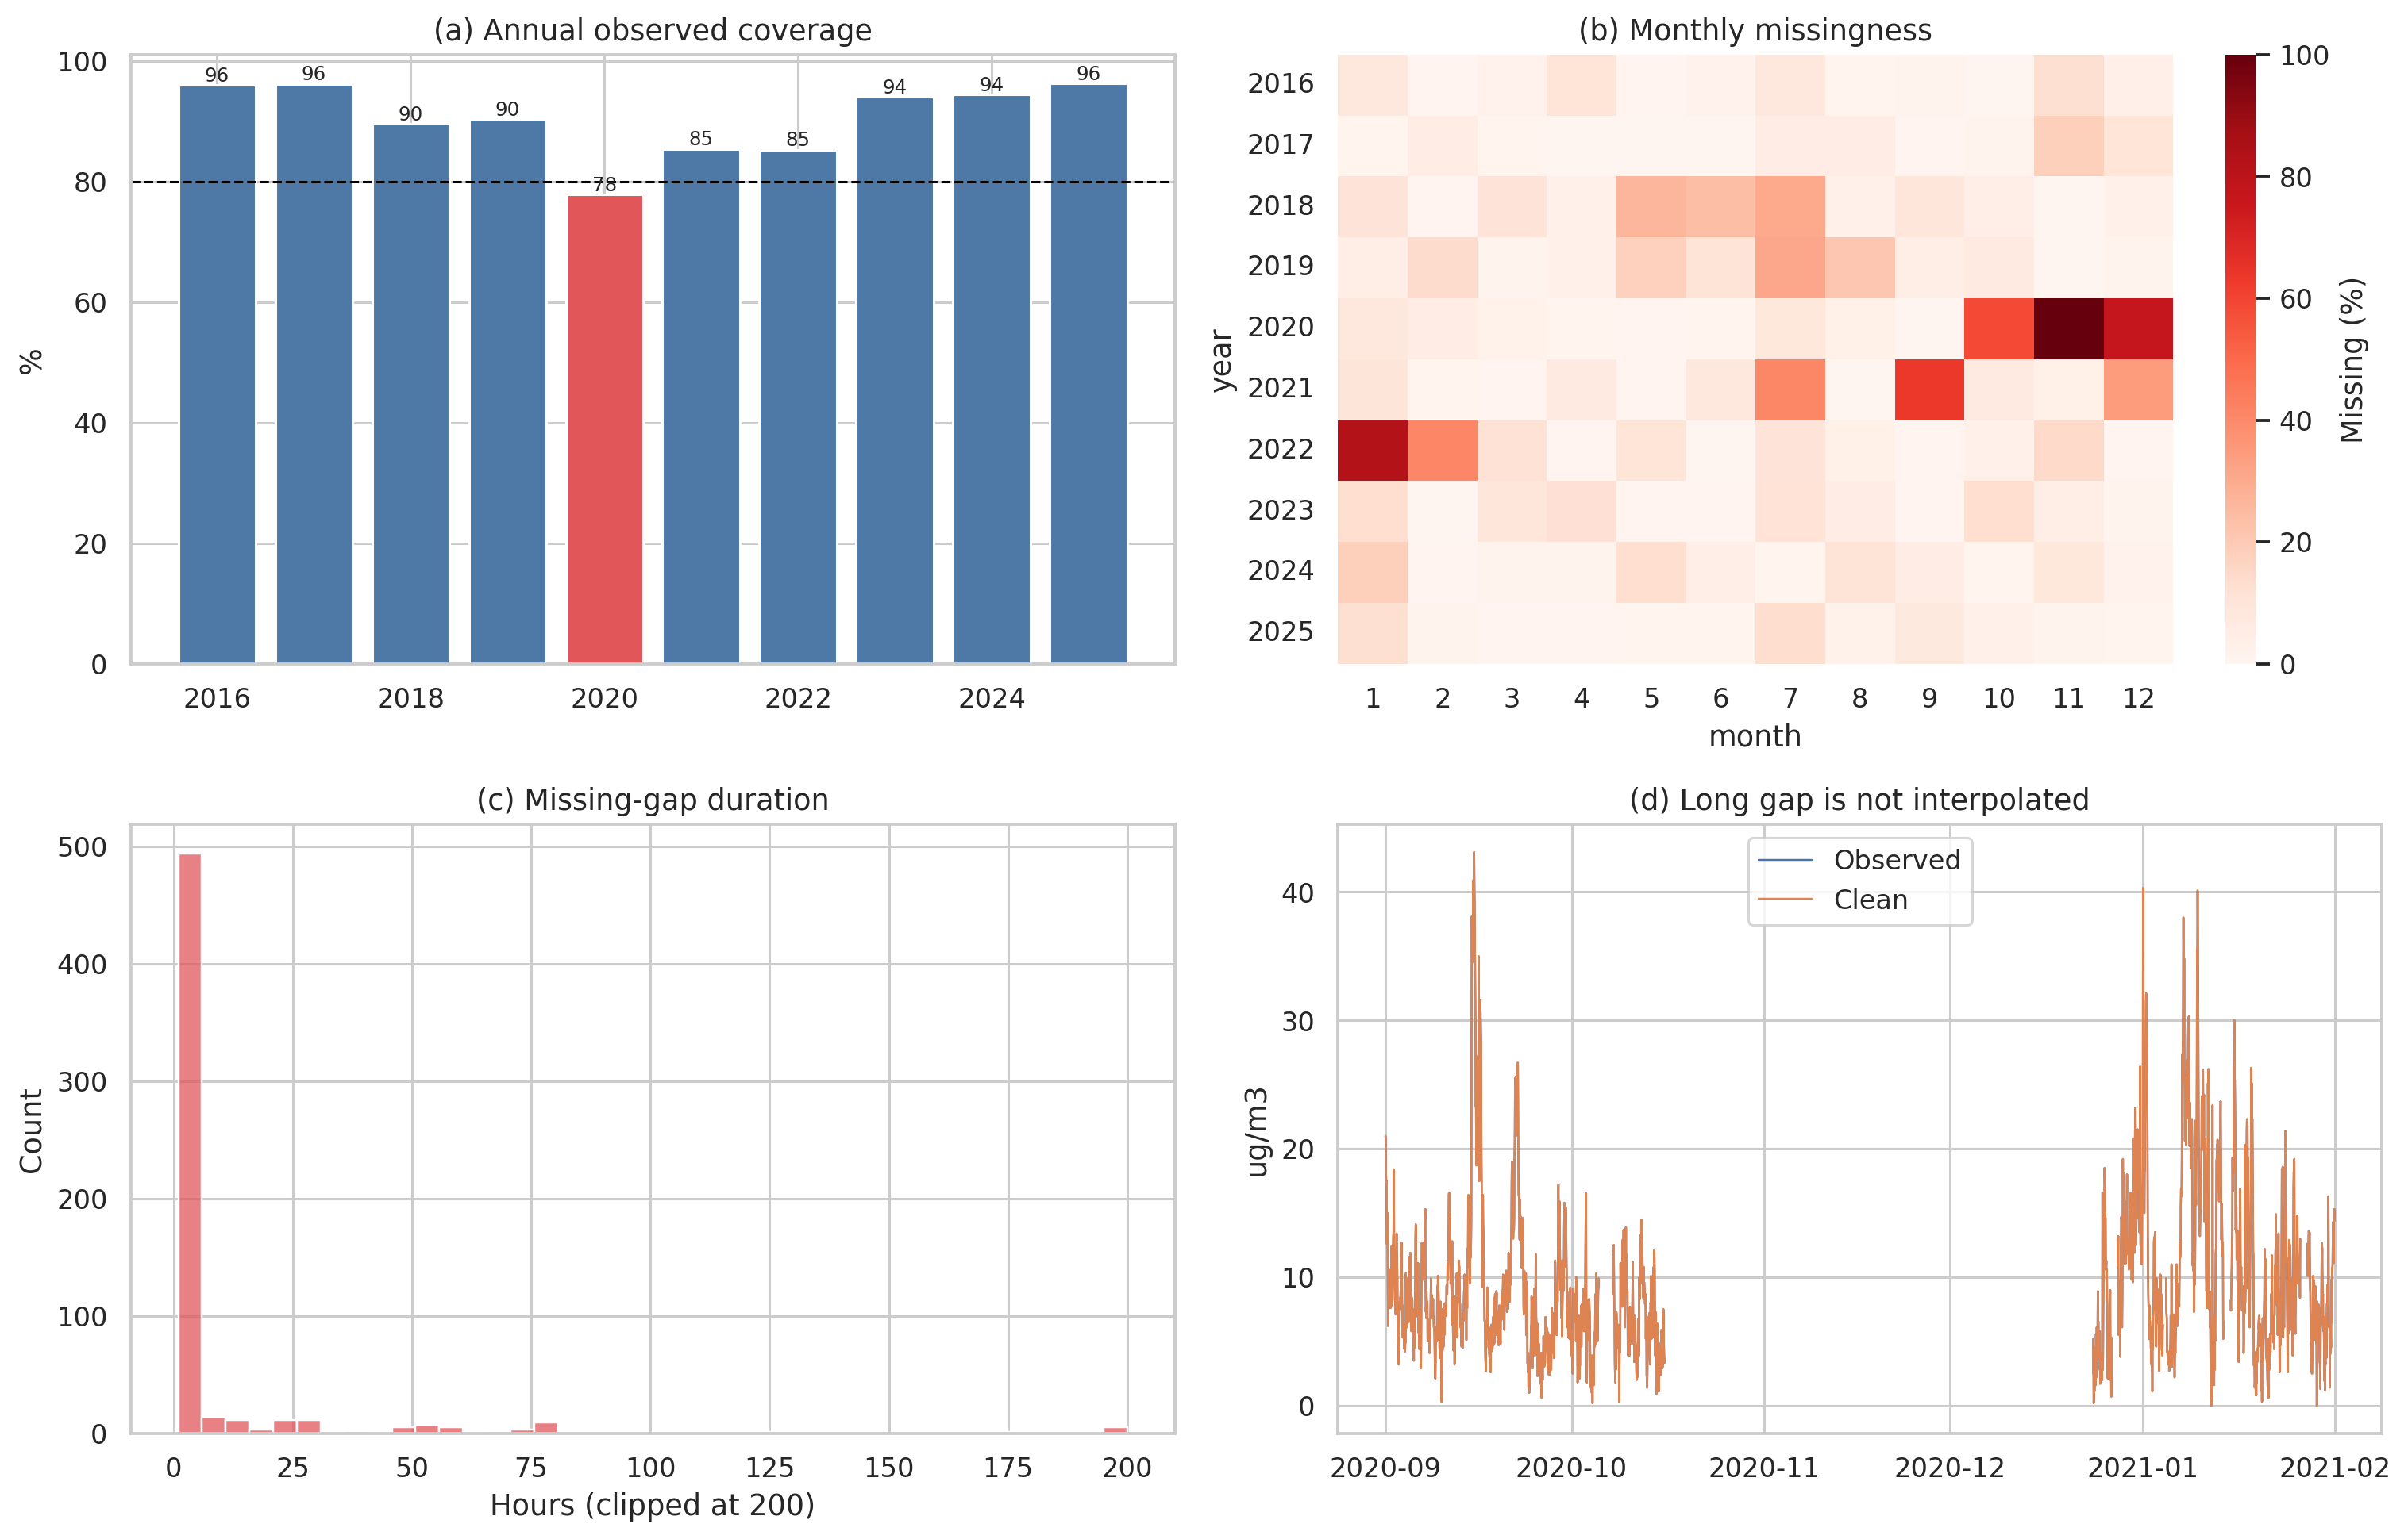
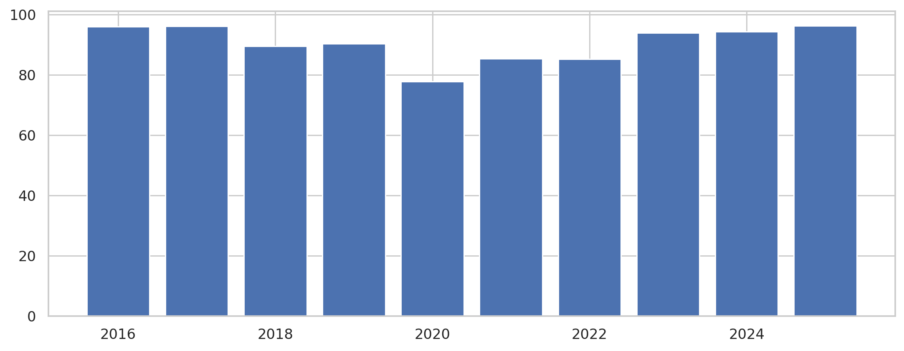
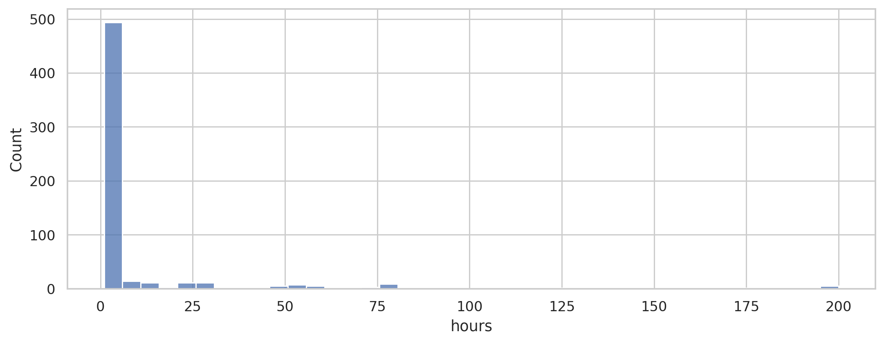
Step 3 - EDA: Bivariate and Multivariate Analysis
Cross-station comparison
? Traffic stations generally show stronger short-term variation.
? Rural/background stations have different missingness and event behavior.
? Horizon difficulty increases from 1h to 48h.
Model implication
A residual layer may help only when calibration evidence shows that TimeMixer errors are systematic.

Slide 8
SQL Queries Linked to Research Questions
Example analytical queries
? RQ1: group MAE by model, station, and horizon.
? RQ2: compare TimeMixer MAE against gated hybrid MAE.
? RQ3: compare available-history results with common-history 2021-2025 results.
Query output used in slides
Model ranking, station effectiveness, residual-gate summary, and history-sensitivity comparison tables.

Slide 9
Step 4 - Feature Engineering
Origin-safe feature design
Step | Rule
Parse | Normalize UK-Air timestamps to a complete hourly grid.
Validate | Convert non-numeric and negative PM2.5 values to missing.
Interpolate | Fill bounded internal gaps of at most three hours only.
Retain | Keep missingness, instrument and station-quality indicators.
Split | Fit scalers and models before calibration and locked testing.
? Lag features from past PM2.5 only.
? Rolling statistics based only on observations available at forecast origin.
? Calendar features such as hour, day, week, and seasonality.
? Gap, interpolation, and instrument-quality flags.

Slide 10
Advanced Data Visualization
Main visualization groups
Data overview
Model comparison
Sensitivity analysis
Data quality
Residual diagnostics
The report keeps only the most important figures in the main text and moves extra EDA to supporting material.

Slide 11
Interactive Dashboard
Dashboard purpose
Component | Setting
Input history | 168 hours
Forecast horizons | 1, 6, 12, 24, 48 hours
TimeMixer scales | 1, 2, 4, 8
Residual layer | Pseudo-Huber XGBoost per horizon
Robustness | Seeds 0-4; maximum 30 epochs
Comparators | Persistence, seasonal naive, XGBoost, DLinear, LSTM, TimeMixer
The project includes an app for exploring generated research artifacts, station data quality, model metrics, and forecast diagnostics.

Slide 12
Step 5 - Dataset Partition
Chronological split
Training: model fitting before 2023.
Validation: early stopping and neural model selection.
Calibration: residual gate selection without test leakage.
Locked test: final evaluation from 2024 onward.
Sensitivity split
A second run uses common 2021-2025 history for all stations to test fairness across unequal station histories.

Slide 13
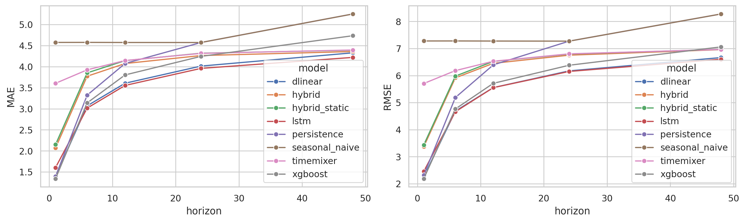
Step 6 - Data Modelling
Compared models
? Persistence and seasonal-naive.
? XGBoost.
? LSTM.
? DLinear.
? TimeMixer.
? Static hybrid and gated hybrid TimeMixer-XGBoost.
Proposed method
TimeMixer produces the base forecast; XGBoost learns residual correction; a calibration gate controls whether correction is used.

Slide 14
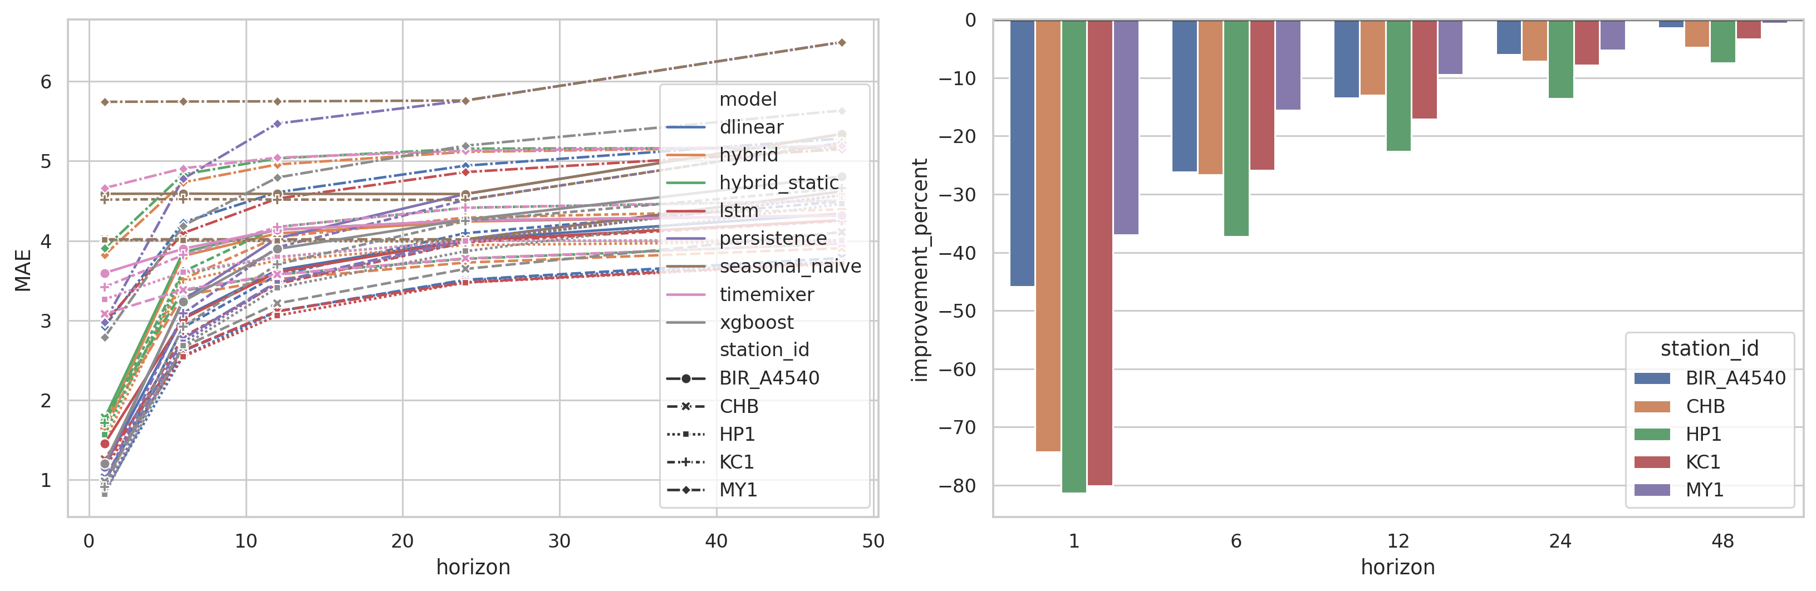
Step 7 - Model Evaluation Table
Main result
? Best pooled model: LSTM, MAE = 3.271.
? XGBoost is strongest at the 1-hour horizon.
? Gated hybrid MAE = 3.708 vs TimeMixer MAE = 4.078.
? Hybrid wins 0/25 comparisons against the strongest comparator.
Interpretation
The hybrid improves TimeMixer but does not beat the strongest baseline overall.

Slide 15
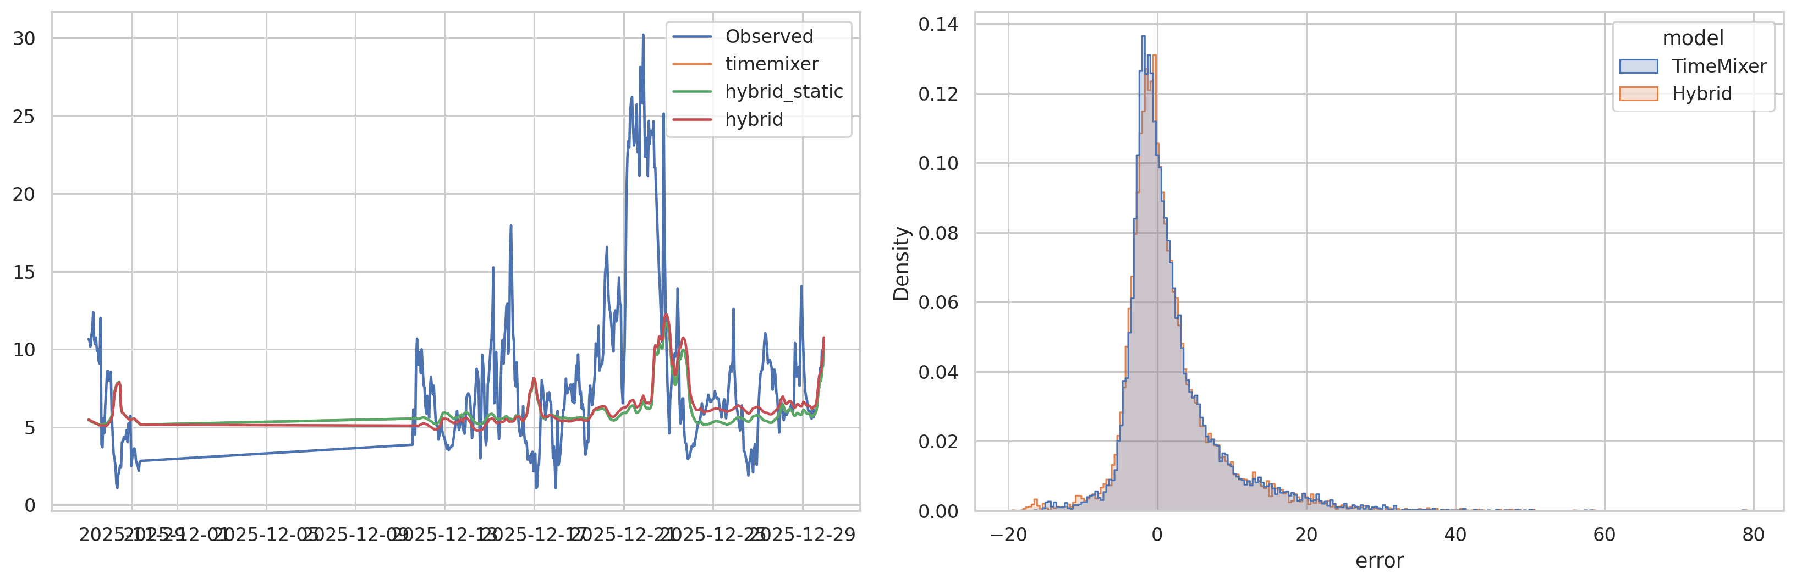
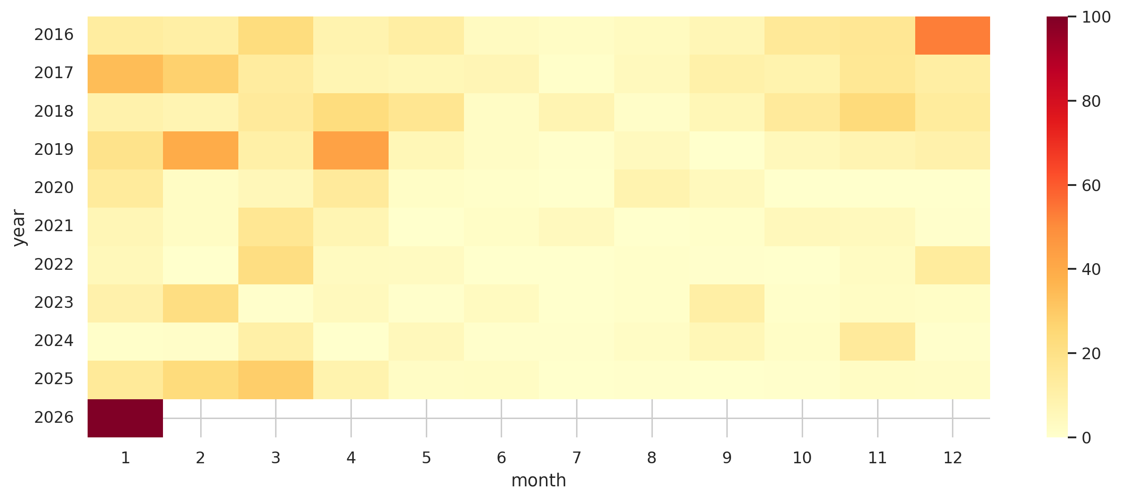
Step 8 - Hyper-parameter Tuning
Neural training setup
? Five seeds: 0, 1, 2, 3, 4.
? Maximum 30 epochs.
? Early stopping, AdamW, gradient clipping, and fixed train/validation/test protocol.
Residual tuning

Slide 16
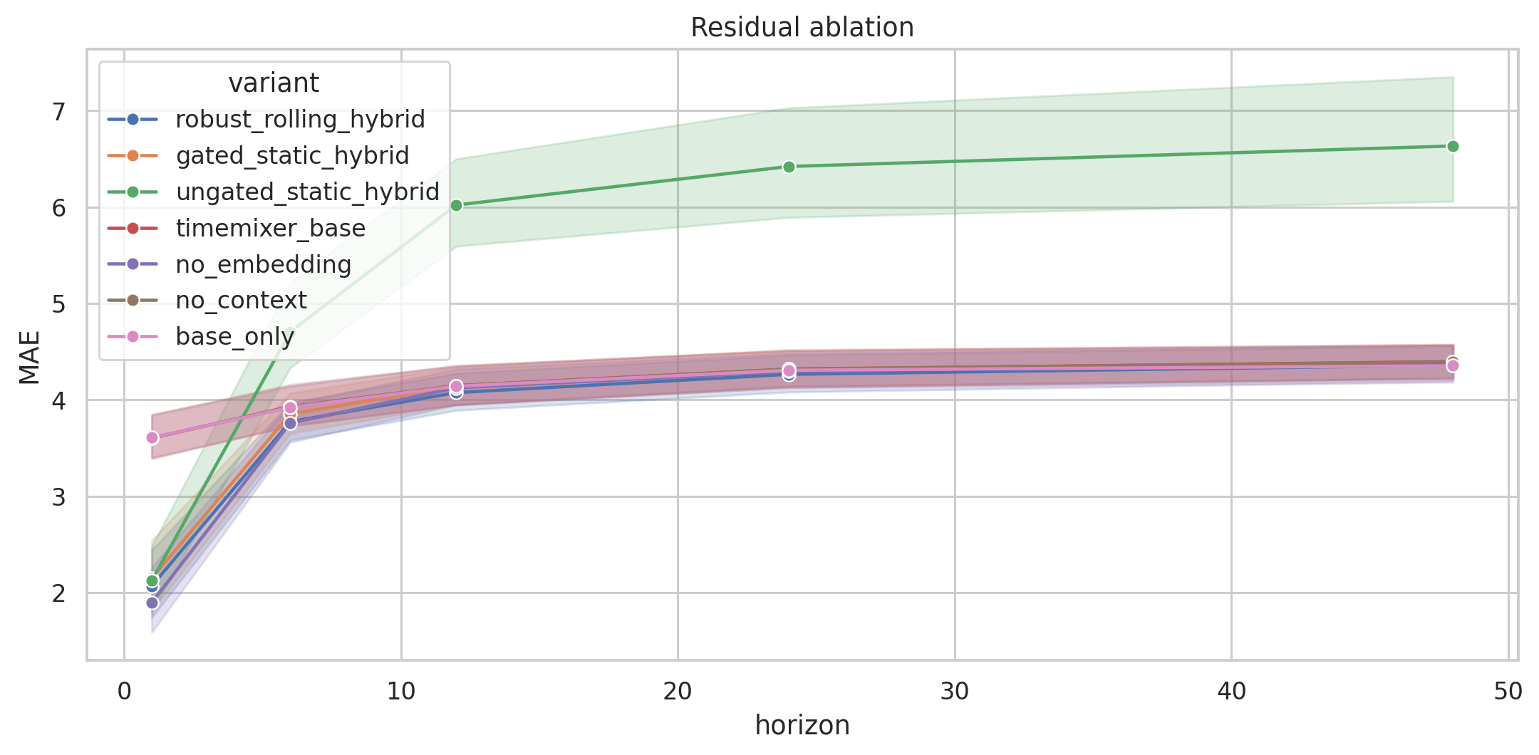
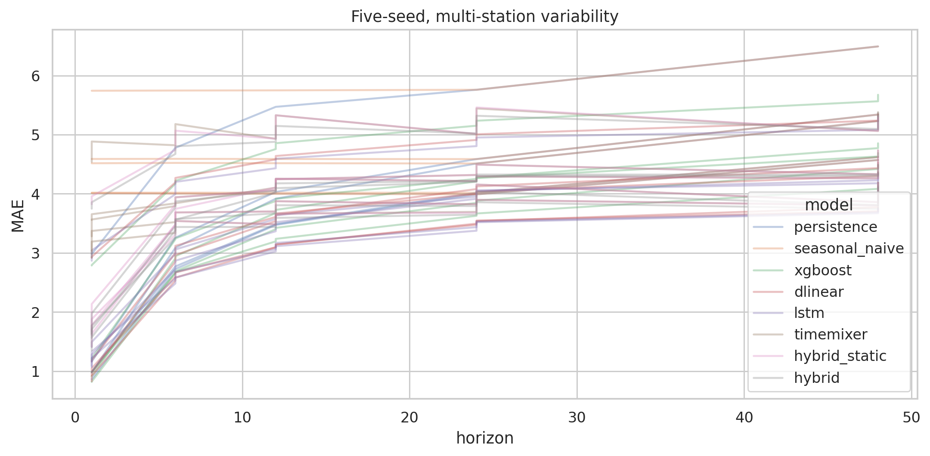
Step 9 - Final Pipeline
Pipeline stages
1. Load station files and audit quality.
2. Clean PM2.5 values and preserve quality flags.
3. Build origin-safe windows and features.
4. Train baselines, TimeMixer, and hybrid models.
5. Evaluate locked test and sensitivity.
6. Export figures, tables, paper, and app artifacts.
Output folders: results/, figures/, diagnostics/, paper/, and app/.

Slide 17
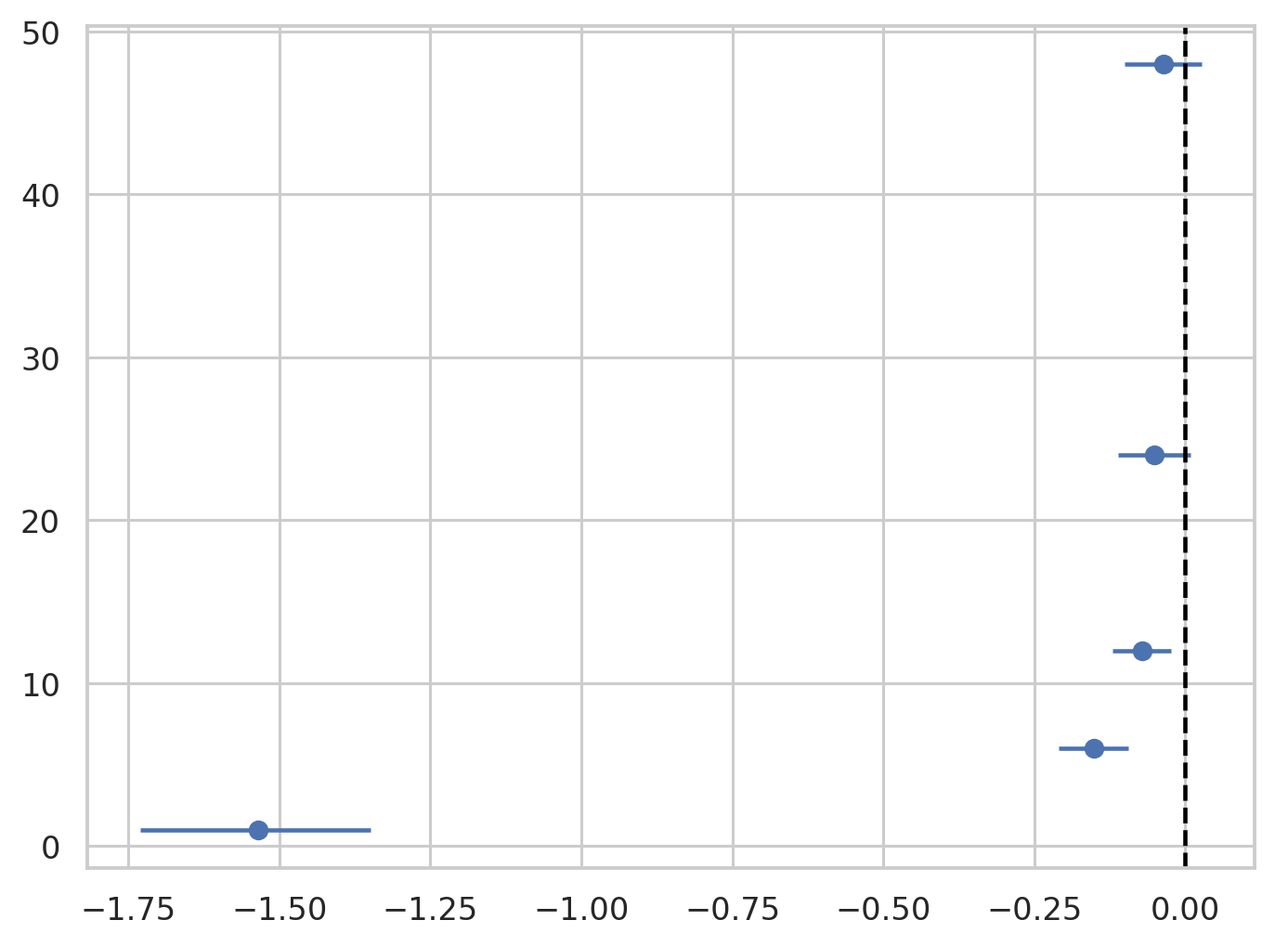
AI-Powered Application / Prototype
Prototype function
The app helps users inspect the completed research results instead of manually opening many CSV and figure files.
AI/data-science value
It connects data cleaning, model comparison, residual diagnostics, and generated visual evidence in one interface.

Slide 18
Develop Applications and AI-Powered Solutions
How the solution could be extended
? Add automated data ingestion from monitoring APIs.
? Add weather covariates for stronger forecasting.
? Deploy the dashboard as a cloud web app.
? Add model retraining and monitoring.
? Add explainability reports for high-pollution events.
Responsible use
Predictions should support analysis, not replace official air-quality information.

Slide 19
Step 10 - Conclusion
Key findings
# | Finding
1 | Five stations, five seeds and 30 epochs provide a broader benchmark.
2 | The gated residual improves TimeMixer at all pooled horizons.
3 | Hybrid wins 0/25 comparisons against the strongest matched baseline.
4 | LSTM is the best pooled model with MAE 3.271.
5 | Common-history sensitivity and strongest-baseline inference remain open.
? The project satisfies the multi-station requirement with five stations.
? The benchmark includes more than five models.
? The gated residual method improves TimeMixer but not the strongest comparator.
? Common-history sensitivity does not reverse the conclusion.

Slide 20
AI Reflection and Q&A

